Slide 1

I/O Systems
St. Thomas’ College of Engineering & Technology
B. Tech. 6th Semester
Operating System [CS - 603]
Lecture – #31 [16-Apr-2018]
Dept. - CSE 6th Sem
Lecturer: Biswajita Dutta
TA: Akshay Anand

Slide 2
WHY STUDY I/O?
Main jobs of computer:
I/O
Processing
In most cases any processing is done by computers in response to some interaction by user through I/O.
60% of codes in Linux have something to do with I/O.

Slide 3
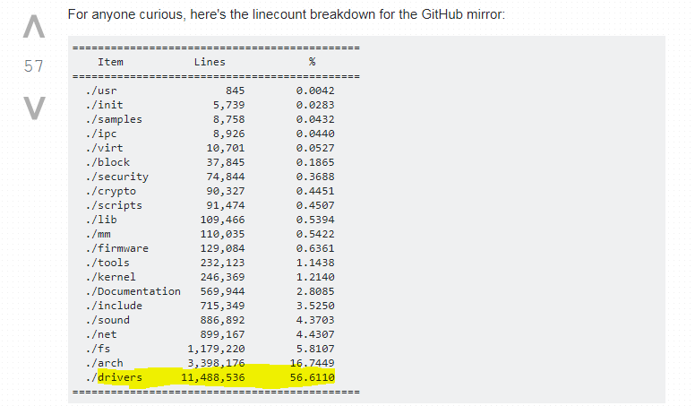
I/O: Importance

Slide 4
Previous year MAKAUT questions
Differentiate b/w blocking and non-blocking I/O [2013(IT)]
What are the advantages and disadvantages of linked file allocation technique? How does indexed file allocation technique overcomes the above disadvantages? [2013(CS) ,2017(IT)]
MCQs
Disk I/O generally done in terms of [2013]
a)sector b)bytes c)blocks d)bits

Slide 5
Basics
I/O devices can be roughly categorized as:
storage
communications
user-interface
and others
Role of computer I/O : Manage and control I/O operations and I/O devices

Slide 6
I/O: Elements
Ports
Bus
Controller
Protocols
Interface
Host
Device

Slide 7
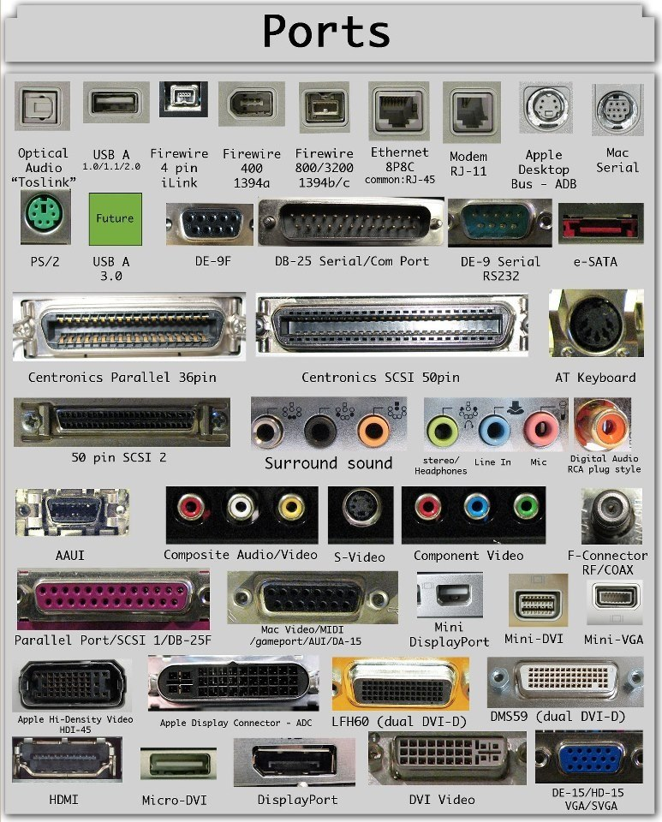
Ports
Devices connect with the computer via ports, e.g. a serial or parallel port.
It is the connection point.

Slide 8
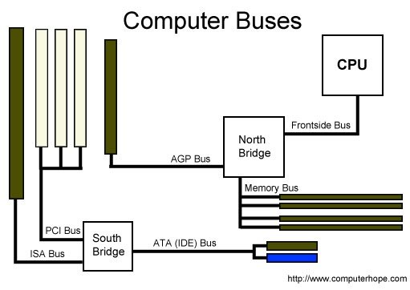
Bus
A common set of wires connecting multiple devices is termed a bus.

Slide 9
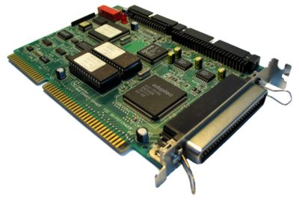
Controller (I/O processor)
A device controller is a part of a computer system that makes sense of the signals going to, and coming from the CPU.

Slide 10
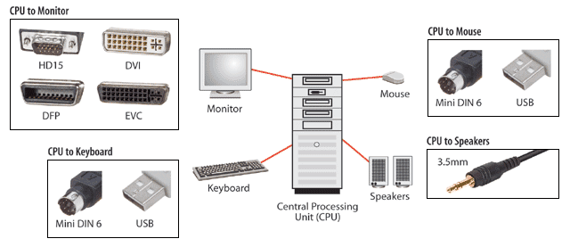
Interface
An interface device (IDF) is a hardware component or system of components that provides abstraction for human beings to interact with a computer, a telephone system, or other electronic information system.

Slide 11
PCI ( Peripheral Component Interconnect )
Used as standard system bus -> for high speed, high bandwidth
Expansion slot -> connects slower low-bandwidth devices, which typically deliver data one character at a time ( with buffering. )
Can connect PCI cards that include:
Network cards
Sound cards
Modems
Extra ports such as USB or serial
TV tuner cards
Disk controllers
Graphics cards

Slide 12
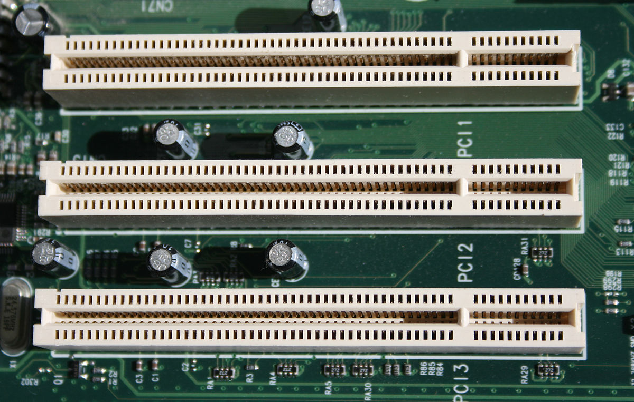
PCI ( Peripheral Component Interconnect )

Slide 13
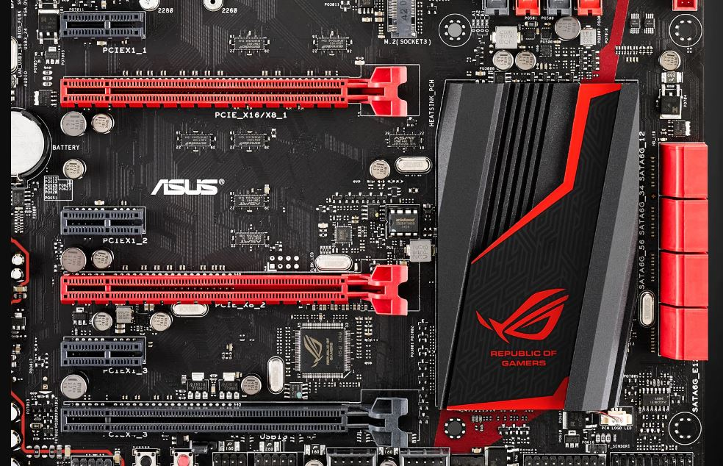
PCIe ( PCI Express)

Slide 14
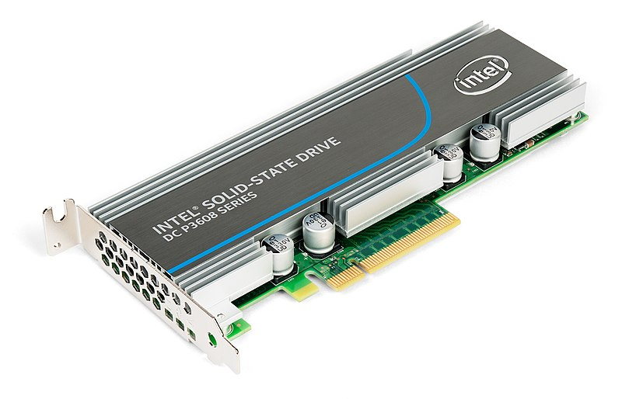
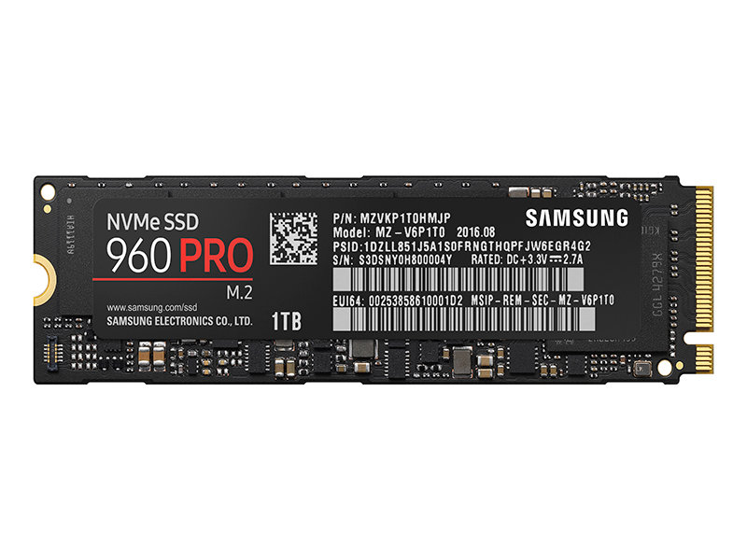
Modern storage options on PCIe
NVMe Flash SSD
NVMe M.2 SSD

Slide 15
Storage I/O interfaces
Parallel
SCSI
ATA/IDE
Serial
SAS (Serial Attached SCSI)
SATA

Slide 16
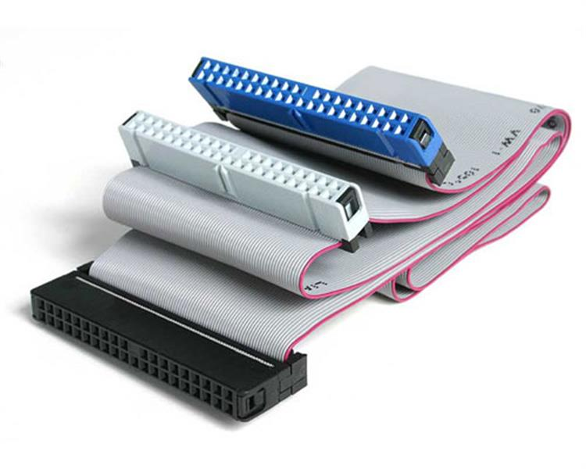
ATA/IDE – Advanced Technology Attachment

Slide 17
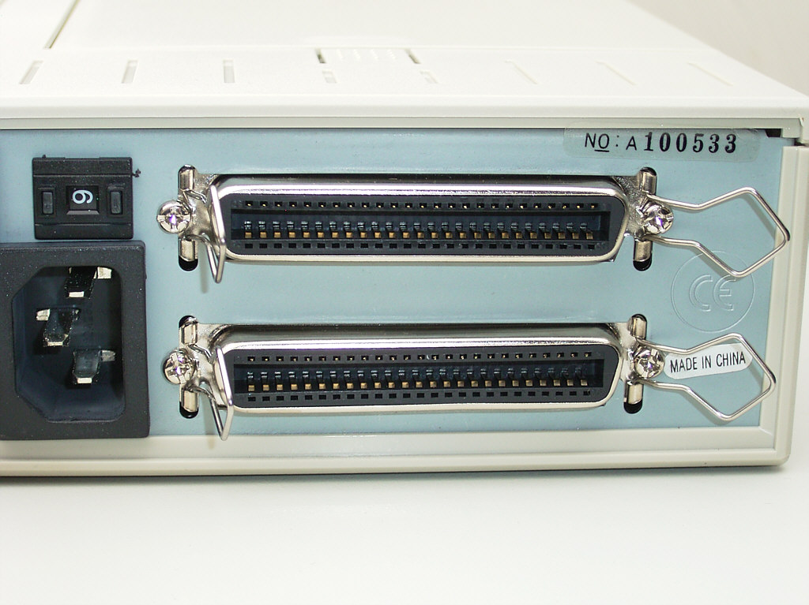
SCSI – Small Computer System Interface

Slide 18
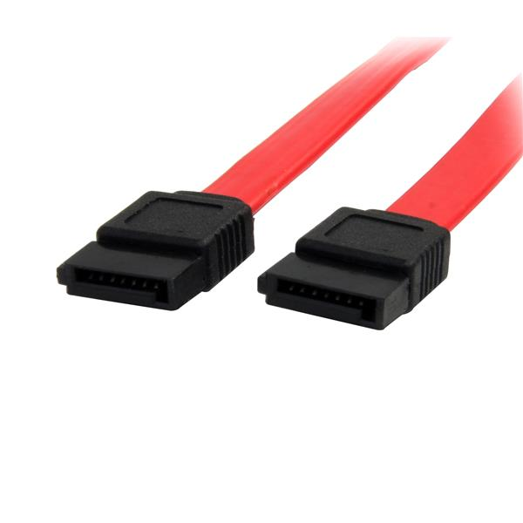
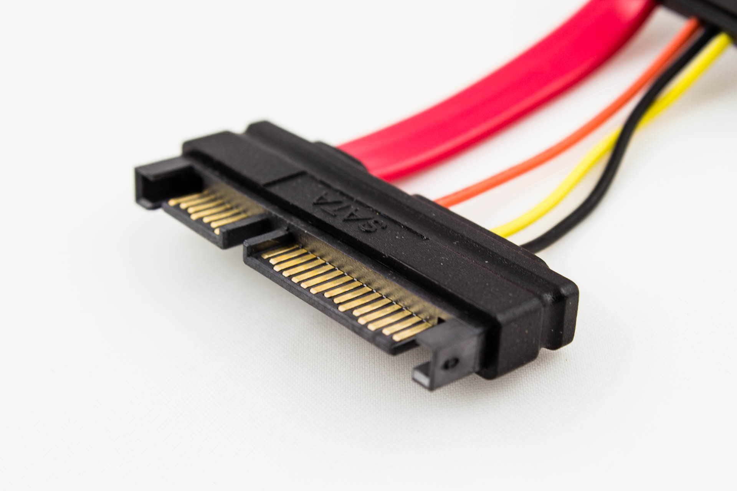
SATA – Serial Advanced Technology Attachment

Slide 19
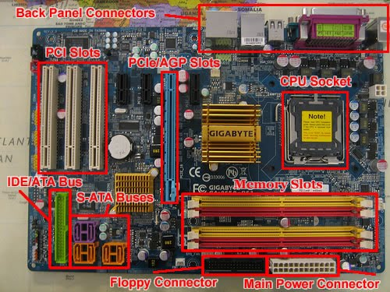

Slide 20
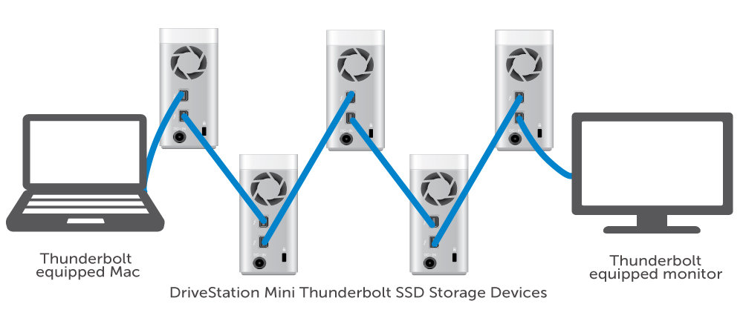
Daisy chaining
A daisy-chain bus is when a string of devices is connected to each other like beads on a chain, and only one of the devices is directly connected to the host.

Slide 21
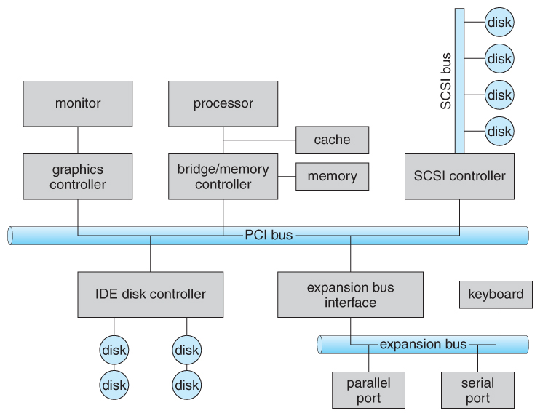
PC Bus Structure

Slide 22
Port registers
One way of communicating with devices is through registers associated with each port. Registers may be one to four bytes in size, and may typically include ( a subset of ) the following four:
The data-in register is read by the host to get input from the device.
The data-out register is written by the host to send output.
The status register has bits read by the host to ascertain the status of the device, such as idle, ready for input, busy, error, transaction complete, etc.
The control register has bits written by the host to issue commands or to change settings of the device such as parity checking, word length, or full- versus half-duplex operation.

Slide 23
Memory mapped I/O vs Peripheral mapped I/O
MMIO | PIO
Data is transferred between any general-purpose register and I/O port. | Data is transferred only between accumulator and I/O port.
Easier to use from programmer’s perspective as existing memory instructions can be used for I/O operations along with general purpose registers. | Harder for programmer as extra I/O instructions need to be used, all of which take single operand (means only accumulator can be used).
The memory map is shared between I/O device and system memory. | The I/O map is independent of the memory map.
More hardware is required to decode address. | Less hardware is required to decode smaller I/O port specific address.
Arithmetic or logical operations can be directly performed with I/O data. | Not the case here

Slide 24
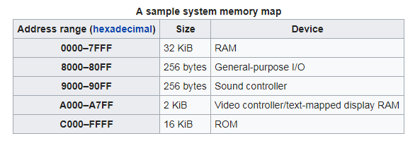
Memory-mapped I/O (MMIO)

Slide 25
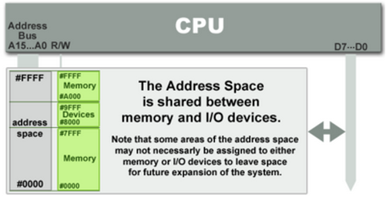
Memory-mapped I/O (MMIO)

Slide 26
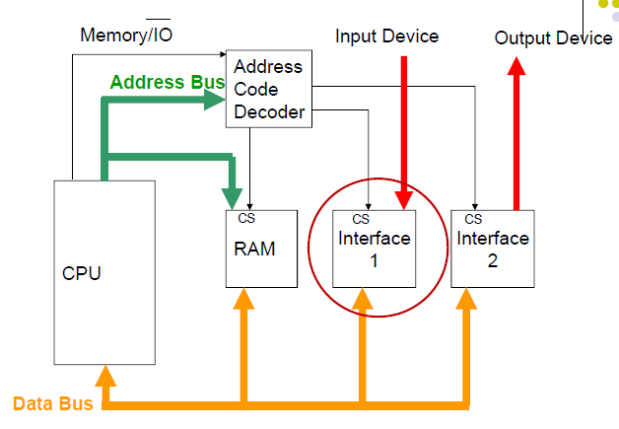
Memory-mapped I/O (MMIO)

Slide 27
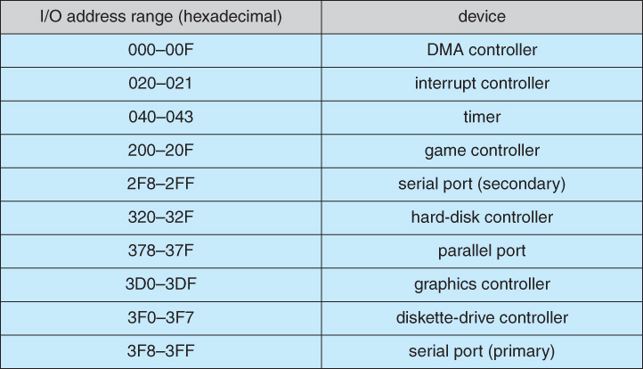
Device I/O port locations on PCs

Slide 28
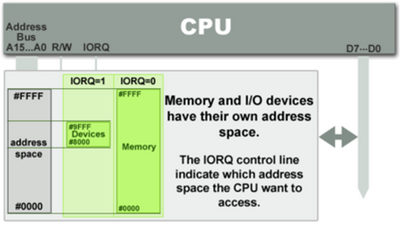
I/O or Peripheral-mapped I/O (PIO)

Slide 29
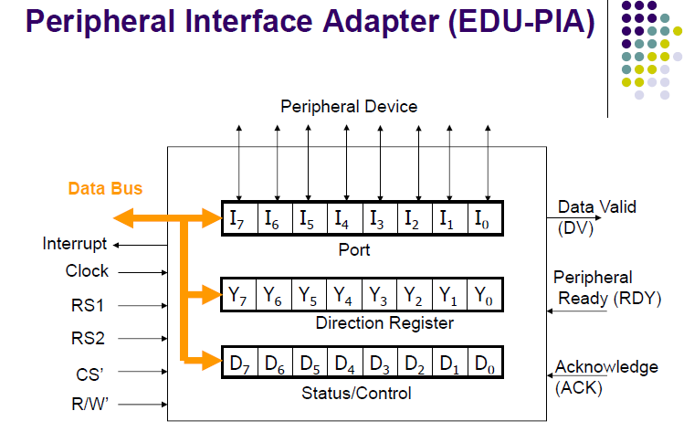
I/O or Peripheral-mapped I/O (PIO)

Slide 30
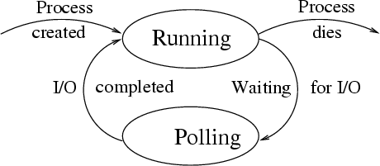
Polling
Polling can be very fast and efficient, if both the device and the controller are fast and if there is significant data to transfer. It becomes inefficient, however, if the host must wait a long time in the busy loop waiting for the device, or if frequent checks need to be made for data that is infrequently there.

